Slide 1
Verilog Design FIFO first-In First-out memory
EE417 Logic Design Using FPGAs
Reference: Advanced Digital Design using Verilog – Michael D. Ciletti

Slide 2
FIFO – First-in first-out memory
A FIFO consists of a stack of a fixed array of registers and a controller that manages the traffic of data to and from the FIFO.
The FIFO provides access to only two register cells at a time, not the entire array of registers.
A FIFO has two address pointers, one for writing to the next available cell, and another one for reading the next unread cell.

Slide 3
The pointers for reading and writing are relocated dynamically as commands to read or write are received, rather than continuously.
The FIFO buffer can receive data until it is full and can be read from until it is empty.
A pointer is moved after each operation. A FIFO has separate address busses and data-paths for reading and writing data and status lines indicating the condition of the stack (full, empty, almost full, almost empty, … etc)
Some FIFOs can accommodate simultaneous reading and writing of data.
The computational activity in the input and output domains can be synchronized by the same clock or by separate clocks, allowing the FIFO to act as a buffer between two clock domains.

Slide 4
EXAMPLE: FIFO DESIGN
Design a FIFO that operates using a common clock for reading and writing. It should operate using a reset. The FIFO has input and output data-paths, and two-bit lines serving as flags to denote the status of the stack (full or empty).
The FIFO module should not support simultaneous read and write and should give preference to the read operation.
Use parameters for the stack height and width.

Slide 5
stack_height -1
FIFO
Data-in
Data-out
clk
stack_full
rst
stack_empty
write_to_stack
read_from_stack
0
FIFO
stack_width -1
0
write_ptr
read_ptr

Slide 6
module FIFO ( Data_out, // Data path from FIFO
stack_empty, // Flag asserted high for empty stack
stack_full, // Flag asserted high for full stack
Data_in, // Data path into FIFO
write_to_stack // Input controlling a write to stack
read_from_stack // Input controlling a read to stack
clk, // clock
rst // reset
);

Slide 7
parameter stack_width = 4; // width of stack and data paths
parameter stack_height = 8; // height of stack (# of words)
parameter stack_ptr_width = 3; // width of pointer to address stack
output [stack_width -1 : 0] Data_out;
output stack_empty, stack_full;
input [stack_width -1 : 0] Data_in;
input clk, rst;
input write_to_stack, read_from_stack;

Slide 8
// Pointers for reading and writing
reg [stack_ptr_width -1 : 0] read_ptr, write_ptr;
reg [stack_ptr_width : 0] ptr_diffr;
reg [stack_width -1 : 0] Data_out;
reg [stack_width -1 : 0] stack [stack_height -1 : 0]; // memory array
assign stack_empty = (ptr_diff == 0) ? 1’b1 : 1’b0;
assign stack_full = (ptr_diff == stack_height) ? 1’b1 : 1’b0;

Slide 9
always @ (posedge clk or posedge rst)
begin
if (rst) begin
Data_out <= 0;
read_ptr <= 0;
write_ptr <= 0;
ptr_diff <= 0;
end

Slide 10
else begin
if ( (read_from_stack) && (!stack_empty) )
begin Data_out <= stack [read_ptr];
read_ptr <= read_ptr + 1;
ptr_diff <= ptr_diff – 1; end
else if ( (write_to_stack) && (!stack_full) )
begin stack [write_ptr] <= Data_in;
write_ptr <= write_ptr + 1;
ptr_diff <= ptr_diff + 1; end
end
end
endmodule

Slide 11
Create a test-bench to test the FIFO operation:
For the testbench use probes to check the contents of the FIFO for testing.
Make sure you test the flag operations (full and empty)
In general, creating probes for internal circuitry may be very helpful in testing a debugging a module operation.

Slide 12
module FIFO_tb ();
parameter stack_width = 4; // width of stack and data paths
parameter stack_height = 8; // height of stack (# of words)
parameter stack_ptr_width = 3; // width of pointer to address stack
wire [stack_width -1 : 0] Data_out;
wire stack_empty, stack_full;
reg [stack_width -1 : 0] Data_in;
reg clk, rst;
reg write_to_stack, read_from_stack;

Slide 13
wire [stack_width-1: 0] stack0, stack1, stack2, stack3,
stack4, stack5, stack6, stack7;
FIFO M1 ( Data_out, stack_empty, stack_full, Data_in,
write_to_stack, read_from_stack, clk, rst );
assign stack0 = M1.stack [0];
assign stack1 = M1.stack [1];
assign stack2 = M1.stack [2];
assign stack3 = M1.stack [3];
assign stack4 = M1.stack [4];
assign stack5 = M1.stack [5];
assign stack6 = M1.stack [6];
assign stack7 = M1.stack [7];
Assign wire probes to check the FIFO contents that are not available as outputs!

Slide 14
always begin
clk = 0; forever #5 clk = ~clk; end
initial #1500 $stop
initial begin
#10 rst = 1; #40 rst = 0; #420 rst = 1; # 460 rst = 0; end
initial #80 Data_in = 1; forever #10 Data_in = Data_in + 1; end
initial fork
#80 write_to_stack = 1;
#180 write_to_stack = 0;
# 250 read_from_stack = 1;
# 350 read_from_stack = 0;
# 420 write_to_stack = 1;
# 480 write_to_stack = 0;
join
endmodule
The fork starts all the processes within in parallel until all the processes are complete.
After the join, all processes are completed one after another.
Notice the difference between the 2nd and fourth initial blocks.

Slide 15
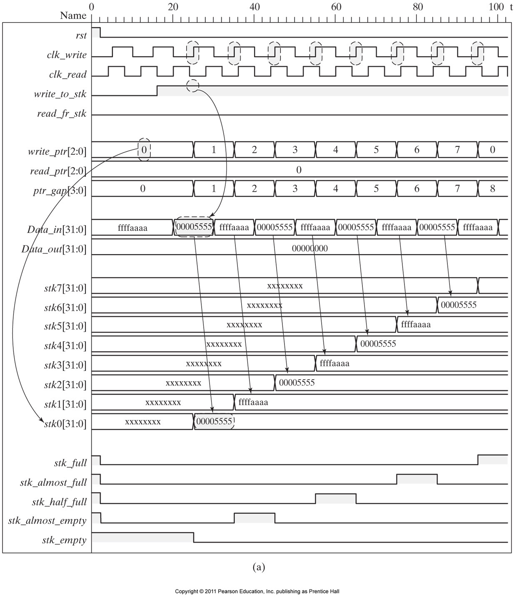

Slide 16


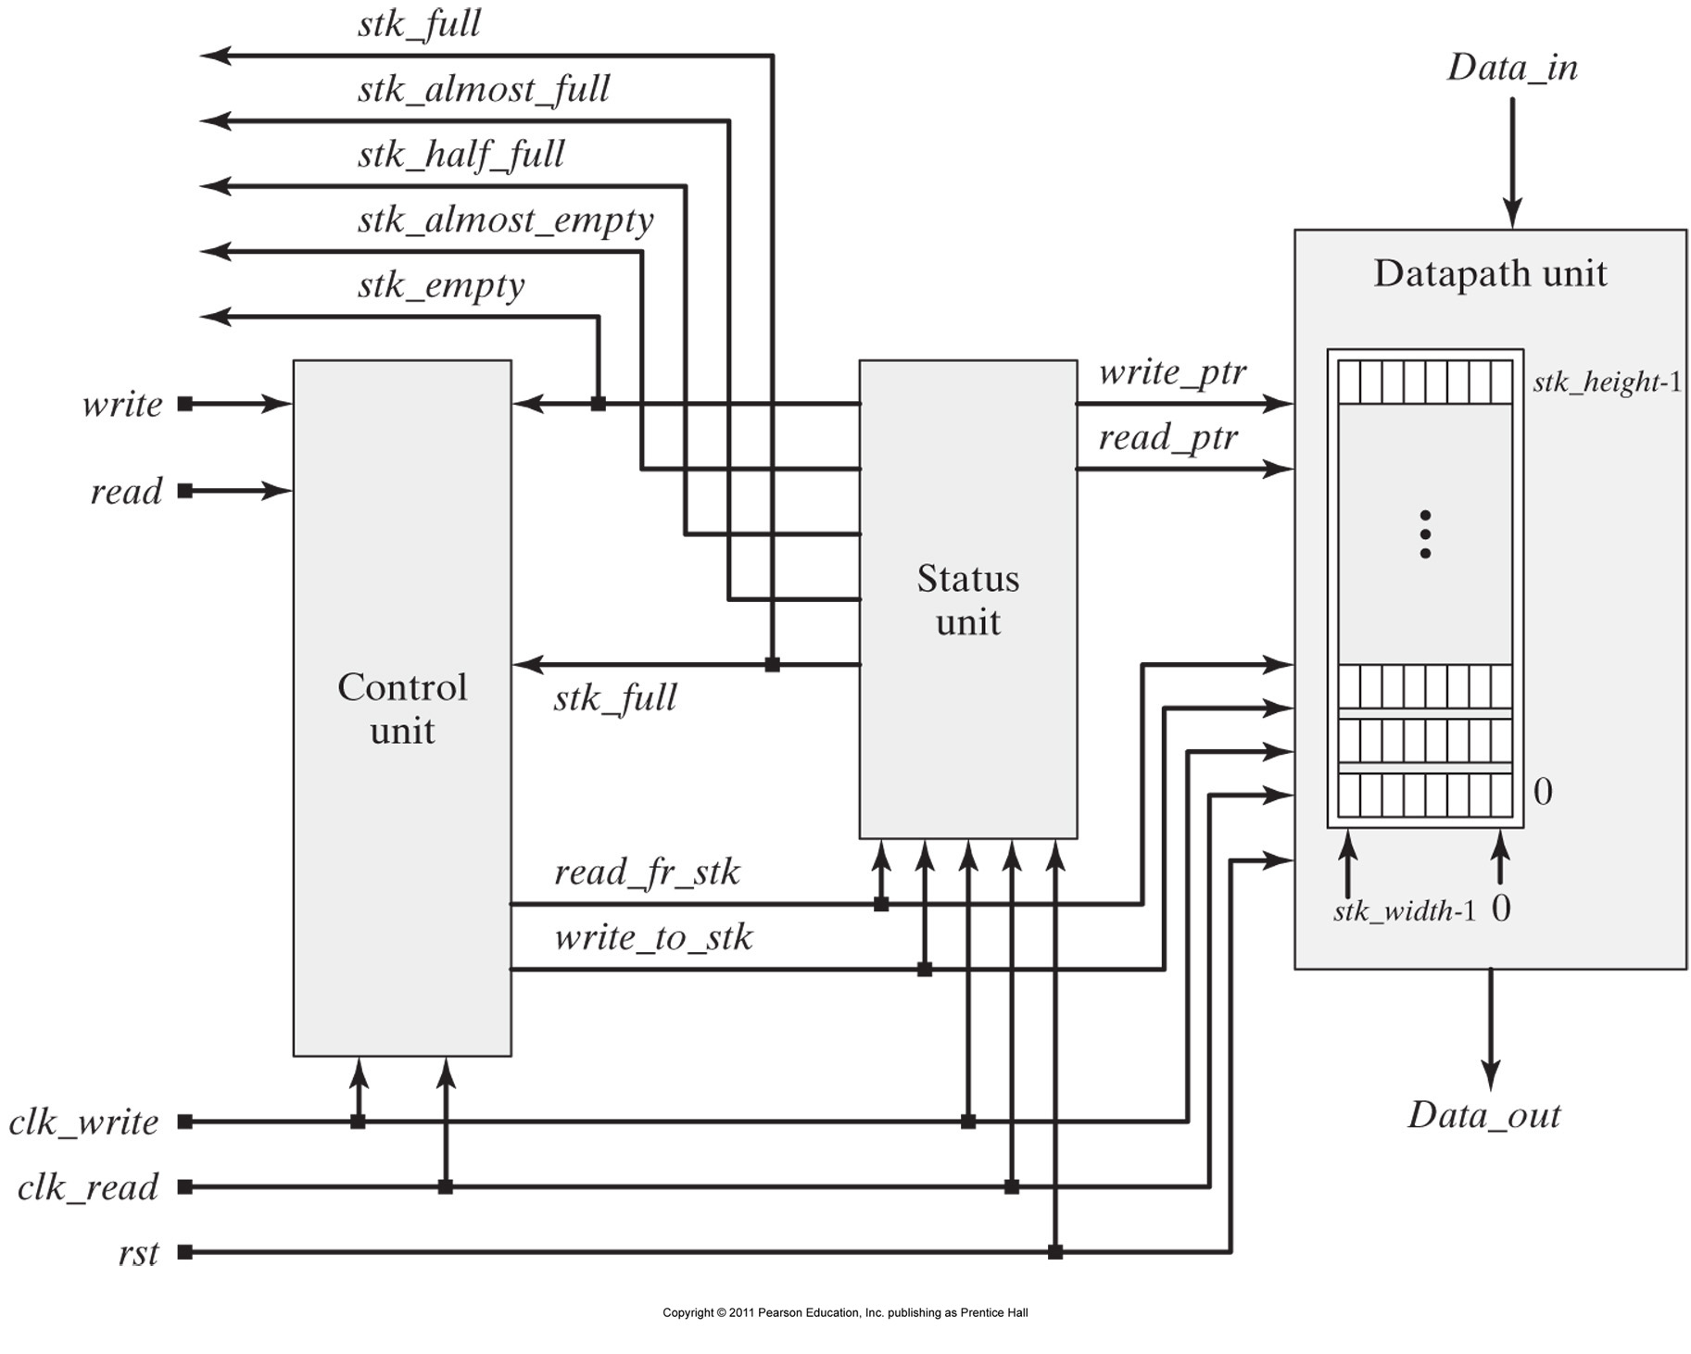
A different design of the FIFO with different clock domains

